Slide 1
caGrid Data Services
Novartis Technical Training
July 22-26, 2009

Slide 2
caGrid Data Services
caGrid Data Services provide capability to expose data resources to the Grid
Specialization of caGrid grid services to expose data through a common query interface
Meet all base service requirements of caGrid services
Present an object view of data sources
Exposed objects are registered in caDSR and their XML representation in GME
Data Service Metadata describes information model
Queries made with CQL Query objects
Results returned as objects nested in a CQL Query Result Set
Graphical Development tool, implemented as an extension to the Introduce Toolkit, is used to create the new grid service

Slide 3
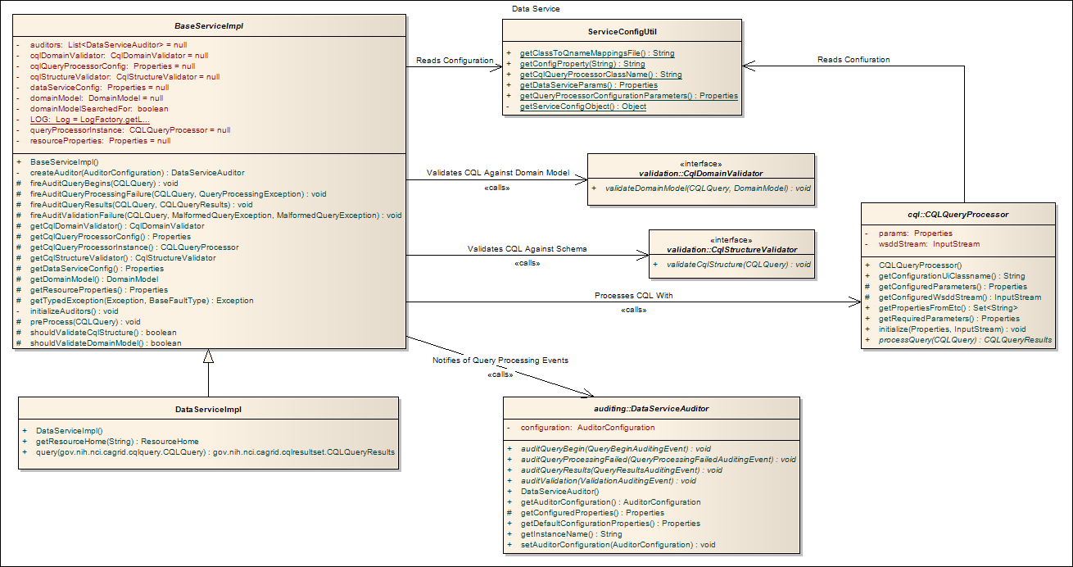
Data Services Architecture

Slide 4
Data Services Architecture
BaseServiceImpl
Abstract base class which is extended by specific data service implementations
Standard, WS-Enumeration, and caGrid Transfer
Common functionality and query processing workflow
Creates and configures the CQL query processor instance
Handles query auditing
Validates incoming queries
DataServiceImpl
Standard implementation of data service extends from BaseServiceImpl
Passes CQL to Query Processor
Returns results directly to client (via grid interface)

Slide 5
Data Services Architecture
ServiceConfigUtil
Reads the data service configuration from JNDI
Introduce-generated ServiceConfig class is populated
Reflection to locate getter methods for data service configuration properties
Works regardless of other service properties added and name of service
Provides service properties to both BaseServiceImpl and CQL Query Processor implementation
Properties supplied in key-value pairs
Keys stripped of prefixes required to identify data service and CQL query processor specific properties

Slide 6
Data Services Architecture
CqlStructureValidator
Interface with a method to validate the well-formedness of a CQL query against the CQL schema
Implementation is reflect-loaded from a class identified in a service property
Optional – May be activated by setting a flag in service properties
CqlDomainValidator
Interface with a method to validate a CQL query against the data service’s domain model
“Are all the associations valid, do the attributes queried for exist, is the specified target data type visible”, etc.
Implementation is reflect-loaded from a class identified in a service property
Optional – May be activated by setting a flag in service properties

Slide 7
Data Services Architecture
DataServiceAuditor
Abstract base class for all auditors
Receives notification of various events in query processing
Query received, exception thrown, etc.
Specified in separate configuration file
Loaded at service startup
Multiple auditors may listen for and handle the same event

Slide 8
Data Services Architecture
CQLQueryProcessor
Abstract base class from which all query processor implementations extend
Abstraction over an arbitrary data source to provide a simple and consistent query interface
Responsible for handling CQL queries against a specific data source
Eg, caCORE SDK, custom MySQL database, Berkley XMLDB, etc.
Loaded via reflection by BaseServiceImpl
Class identified by service property and discovered by ServiceConfigUtil

Slide 9
CQL Query Processors
Configuration related methods
getRequiredParameters()
Returns a Properties instance populated with keys and default values for configuration of the query processor
getPropertiesFromEtc()
Returns a Set of property keys whose value should be a file in the service’s etc directory once deployed to a service container
Useful for locating additional configuration documents
initialize()
Invoked by the data service infrastructure when constructing a CQL Query Processor instance for use in a live service.
Sets the configuration properties from values in service’s JNDI

Slide 10
CQL Query Processors
Query Processing related methods
getConfiguredParameters()
Gets the configuration properties as configured by the data service
For use configuring the query processor when a CQL query is to be executed
Will return null until the data service infrastructure populates it via the initialize method at service start time
processQuery()
Backend data source specific implementation of CQL
May throw a Query Processing Exception if a problem is encountered handling the CQL query
Underlying database has a problem, etc
May also throw a Malformed Query Exception if the CQL query itself is non-conformant
Typically handled by query validators, but may be used for non-supported query operations

Slide 11




Simplified service development process
Specialized tooling can create a fully functional data service without a single line of developer code
Templates, wizards, and simple configuration files
Re-use of silver-level caBIG services and tools
Create Semantically Harmonized Data Model
Generate
Data Resource
Grid-ify

Slide 12
Simplified service development process
Data Service Extension to Introduce
Automatically copies Jars, Schemas, and WSDLs
Adds standard query method to service
Can optionally add methods for WS-Enumeration and Transfer
Adds supporting service extensions as needed
Extendable via data service styles
Multiple extension points
Creation of service
Editing in Introduce with style-specific UI tab
Modification (save and synchronize)
Allows specialization of the data service extension
Includes service creation wizard functionality
Complicated and custom tooling can be made organized and easily repeatable

Slide 13
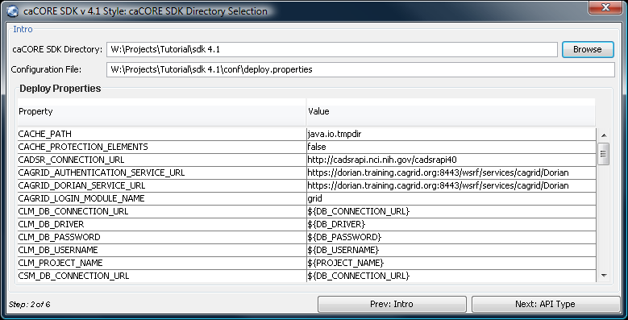
Data Service Styles
Defined by an XML document embedded in the extension directory
Specified classes are reflect-loaded and executed
Styles provided for caBIG silver-to-grid workflow
caCORE SDK versions 3.1, 3.2, 4.0, and 4.1
Third-party styles available
Ex: Berkley DBXML

Slide 14
Data Service Clients
Single, Common Client
All data services can be queried via the same client class
Possible because all data services implement the same WSDL
Standard client has single public method
CQL query in, CQL query results out
Client for each specific service works too
Methods unique to the service are available via the custom client.
Constructed like any other Introduce-generated client
Service URL / EPR and optional Grid Credential

Slide 15
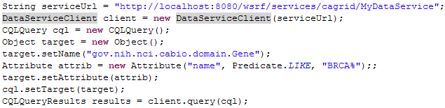
Data Service Clients
Example client set-up and invocation:
The service URL is defined
The common data service client is created with the URL
A new CQL query object is created
Its target is set to gov.nih.nci.cabio.domain.Gene
The target is constrained by name attributes with values like brca%
The query is executed by the data service and results are returned

Slide 16
caGrid Query Language (CQL)
Simple, “minimum entry” for data providers
Specifies a target object (result) type and selects the instances which satisfy the specified properties and nested object properties
Allows path navigation
Provides logical grouping
Provides name/predicate/value filtering on properties of objects
Recursively defined
Ability to return full Objects, Set of attributes, count of results, or distinct attribute values

Slide 17
caGrid Query Language (CQL)
Defined by XML schema
Published in GME
Included in every caGrid Data Service
Queries constructed in one of two ways
CQL object API
Java beans derived from CQL schema
Simple getter / setter functionality to add query components
Written XML document
Deserialized into CQL object and used with data service client API
Passed by other means over SOAP interface

Slide 18
Parts of a CQL Query
Object
Base for search criteria and target definition
Contains the name of the data type / class being searched for
May have one of three child query parts
Association, Attribute, or Group
Target
Top level query component extends from Object
Identifies the data type which will be returned by the query
Association
Lower level query component extends from Object
Restricts query results
Must be non-null
Further associations, attributes, or groups as child query components

Slide 19
Parts of a CQL Query
Attribute
Object property used as search criteria
Defined in terms of attribute name, predicate, and value
Predicates are similar to SQL
Equals, Not Equals, Like, Less Than, Greater Than, Less or Equal, Greater or Equal, Null, and Not Null
Group
A logical join of child search criteria
Logical operators AND / OR
May have one or more Attributes, Associations, or additional Groups in combination

Slide 20
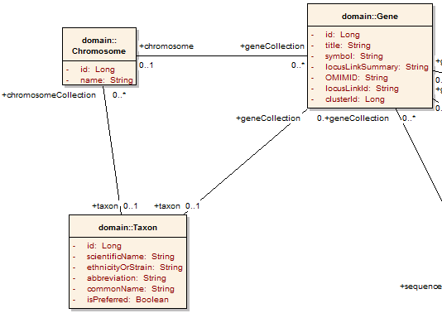
Example CQL Query
Return all Genes:
<CQLQuery xmlns="http://CQL.caBIG/1/gov.nih.nci.cagrid.CQLQuery"> <Target name="gov.nih.nci.cabio.domain.Gene"> </Target> </CQLQuery>
Notes:
This next phase runs through developing a query for a data service showing how the domain model describes the queryies that can be generated and the CQL language lets you express the query. This example is showing a simple model where all we want to do is qeury the DB for all Genes.

Slide 21
Example CQL Query
LIKE “BRCA%”
Return all Genes with a symbol beginning with BRCA:
<CQLQuery xmlns="http://CQL.caBIG/1/gov.nih.nci.cagrid.CQLQuery"> <Target name="gov.nih.nci.cabio.domain.Gene"> <Group logicRelation="AND"> <Attribute name="symbol" predicate="LIKE“ value="BRCA%"/> </Group> </Target> </CQLQuery>
Notes:
Now we get more specific and add some more filtering to our query buy having it only return genes that have a symbol “LIKE” BRCA and a wildcard

Slide 22
Example CQL Query
LIKE “BRCA%”
Return all Genes with a symbol beginning with BRCA and have an associated Taxon:
<CQLQuery xmlns="http://CQL.caBIG/1/gov.nih.nci.cagrid.CQLQuery"> <Target name="gov.nih.nci.cabio.domain.Gene"> <Group logicRelation="AND"> <Attribute name="symbol" predicate="LIKE“ value="BRCA%"/> <Association roleName="taxon“ name="gov.nih.nci.cabio.domain.Taxon"> </Association> </Group> </Target> </CQLQuery>
Notes:
Net we will get even more specific and say I we only want those same genes from before but only if they have an associated Taxon instance.

Slide 23
Example CQL Query
LIKE “BRCA%”
Return all Genes with a symbol beginning with BRCA and have an associated Taxon with a scientificName equal to “Homo sapiens”:
<CQLQuery xmlns="http://CQL.caBIG/1/gov.nih.nci.cagrid.CQLQuery"> <Target name="gov.nih.nci.cabio.domain.Gene"> <Group logicRelation="AND"> <Attribute name="symbol" predicate="LIKE“ value="BRCA%"/> <Association roleName="taxon“ name="gov.nih.nci.cabio.domain.Taxon"> <Attribute name=“scientificName" predicate=“EQUAL_TO” value=“Homo sapiens"/> </Association> </Group> </Target> </CQLQuery>
= “Homo sapiens”
Notes:
And lastly we will even futher specify our search to say not only do we want a taxon to exist but that taxon needs to be from the homo sapiens genus.

Slide 24
CQL Query Results
Multiple Result Types
Object results encapsulate complete data types / classes
Attribute results contain key-value pairs grouped by the individual object instances from which they are derived
Count results contain a single long value indicating the count of object instances which satisfy the search criteria
Allowable Types
Data services infrastructure generates a custom “CQLResultTypes” schema
Contains an xsd:choice of all allowable return types for CQL object results
Imported into and available to clients via the data service WSDL
Clients know what types to expect and handle

Slide 25
Handling CQL Results
CQLQueryResultsIterator
Implements java.util.Iterator
next() can return deserialized objects or XML text
Configured by client-config.wsdd document at construction
Optional – needed for custom object deserialization
DataServiceIterator
Interface that takes a CQL query and returns an Iterator
Implementations for standard, BDT, and WS-Enumeration
Simplifies creation of an Iterator for every query result

Slide 26
Handling CQL Results
Alternative results retrieval
Intended to aid handling of large data sets
WS-Enumeration
An interface by which clients may page results from a grid service
Special results-retrieval service resource and context
Client specifies page size
Number of data elements, max size of results in bytes, timeout
caGrid provides server-side and client-side tooling to simplify use of WS-Enumeration
An Introduce extension manages server-side configuration
caGrid Transfer
Avoids serialization / deserialization overhead
Client sees a Java InputStream and can read from it as usual

Slide 27
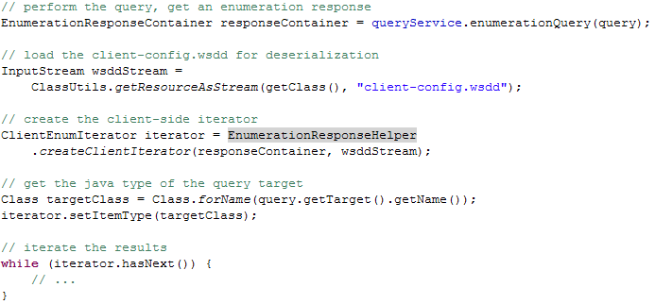
Handling CQL Results
Example with WS-Enumeration
EnumerationResponseHelper is a caGrid helper class which contacts the results service context using the proper resource key and creates a client handle to it
Default iteration constraints retrieve 10 results at a time from the service with no restriction on number of bytes or timeout

Slide 28
Data Service Client Workflow
Client wishes to locate some data on the grid
A researcher is studying breast cancer, and wishes to locate related genomic information on the grid
This client knows they want Genes with a certain name, but does not know which service might contain them, nor how to structure a query for them
Client has joined a grid
NCI production grid, for example
Local clients and infrastructure configured to utilize specific services for metadata, security, advertisement, discovery, etc.
Discovery client API will use the default index service URL if one isn’t explicitly provided

Slide 29
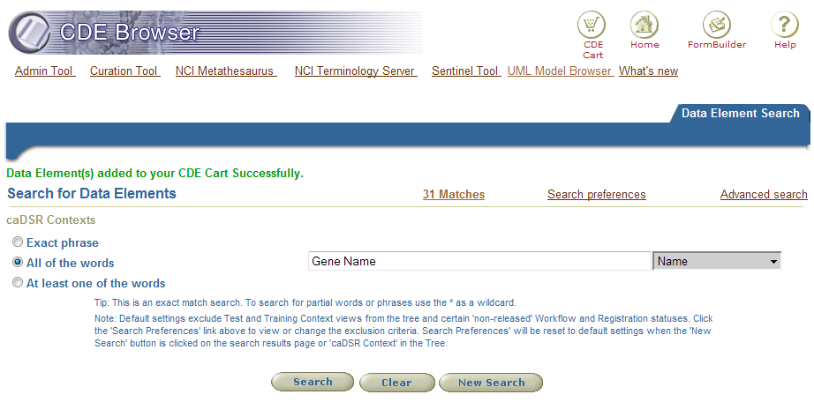
Data Service Client Workflow
Discovering Services by CDE
Using the CDE browser, the researcher looks for the phrase “Gene Name”

Slide 30
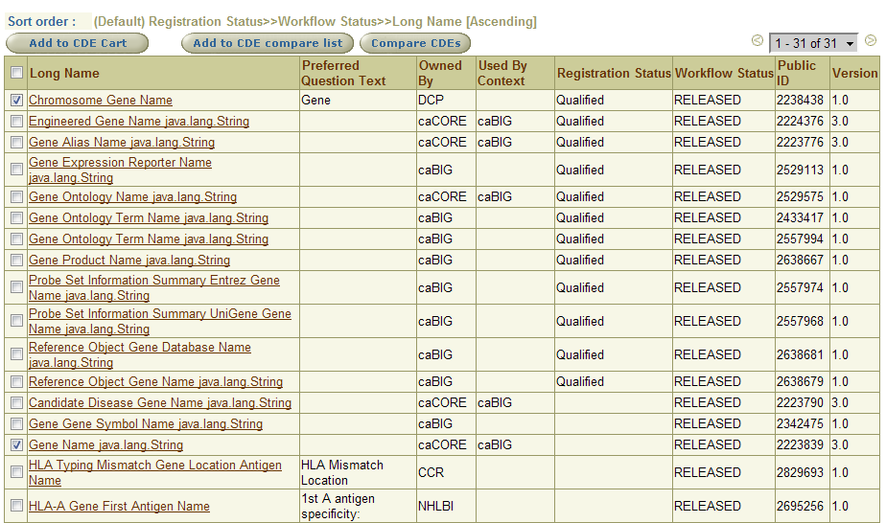
Data Service Client Workflow
Selecting data elements
Many matching data elements are found
The researcher selects a few likely candidates

Slide 31
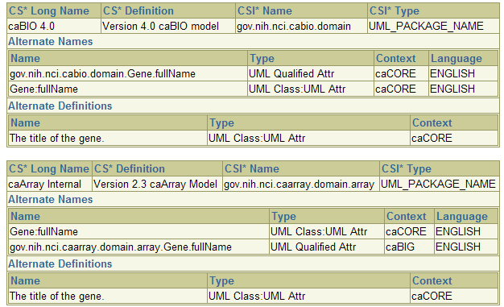
Data Service Client Workflow
The Gene Name owned by caCORE and used by caBIG looks like a good place to start…
This data element is used in a number of models, so it’s likely to appear on the grid as well

Slide 32
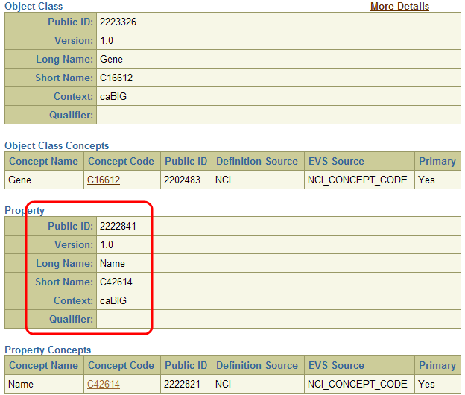
Data Service Client Workflow
Several Concept Codes are associated with this data element
The researcher is interested in the Name attribute
Code C42614

Slide 33
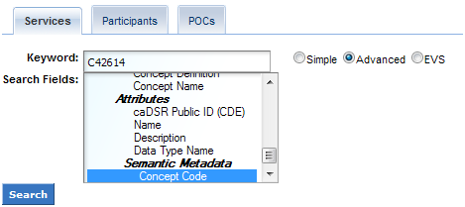
Data Service Client Workflow
The concept code can be used to discover service EPRs
In the caGrid Portal, data services can be searched
Domain Model exposes classes and attributes
Attributes with Semantic Metadata and Concept Codes

Slide 34
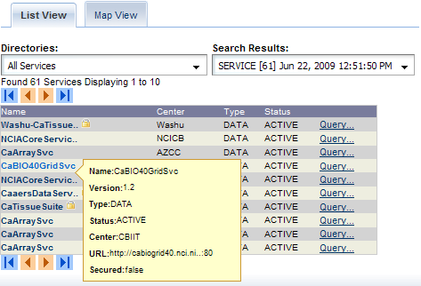
Data Service Client Workflow
Several services are found
The caBIO 4.0 Service maintained by CBIIT is selected

Slide 35
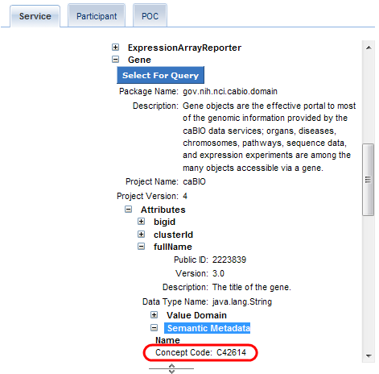
Data Service Client Workflow
The Domain Model can be browsed
The Gene class and fullName attribute is found
The same Concept Code we found in the CDE browser and searched for in the portal is associated with this attribute

Slide 36
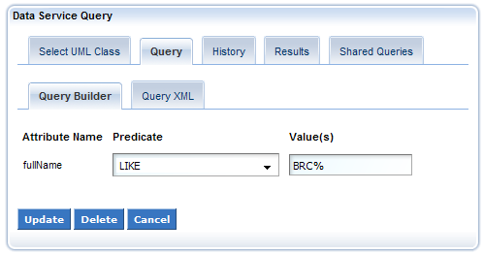
Data Service Client Workflow
Create a query
Researcher selects the Gene data type for query
Portal generates a CQL query targeting the Gene datatype
Researcher selects “Add Criterion” to restrict the fullName attribute
Selects the predicate “LIKE” and enters the value “BRC%”

Slide 37
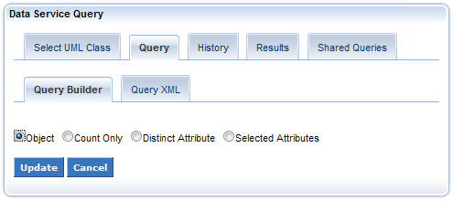
Data Service Client Workflow
Retrieve Objects
The portal defaults all queries to return a count of the data instances a query returns
Researcher chooses to Edit Query Modifiers
Selects Object rather than Count

Slide 38
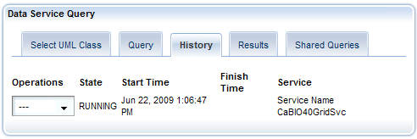
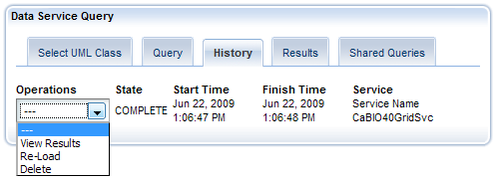
Data Service Client Workflow
Submit the query
State is updated when results are ready
Researcher can view the results

Slide 39
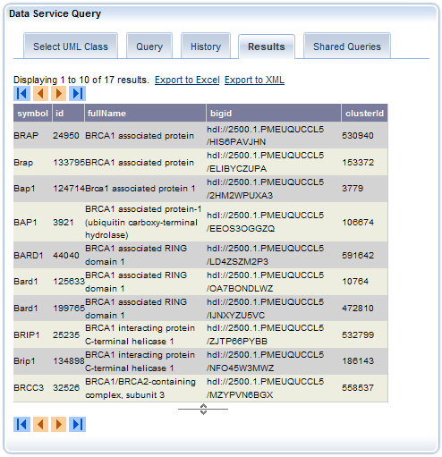
Data Service Client Workflow
Viewing the results
17 results from this service

Slide 40
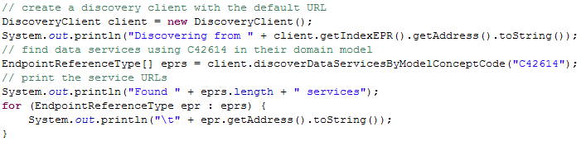
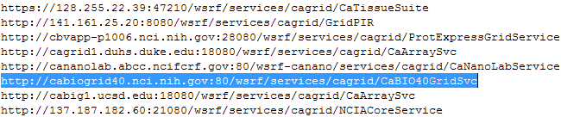
Data Service Client Workflow
Using the Discovery API
Still need the Concept Code from the CDE browser
C42614 for this example
59 services found (NCI production grid)
Including the caBIO 4.0 service used in the portal example

Slide 41

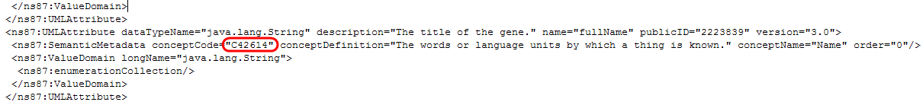
Data Service Client Workflow
Obtaining a domain model
The domain model defines what classes, attributes, and associations are available
Also contains semantic metadata, including concept codes
Metadatautils project has facilities for working with and obtaining domain models from caGrid data services
We can find the concept code in the model

Slide 42
Data Service Client Workflow
Using the domain model
Utilize the CQL object API to build up a query
Walk through classes, looking for a “Gene” class
Iterate that class’s attributes
Inspect each attribute’s semantic metadata for the concept code C42614
Once the attribute is found, set the CQL query target
Restrict the target by the attribute’s value

Slide 43
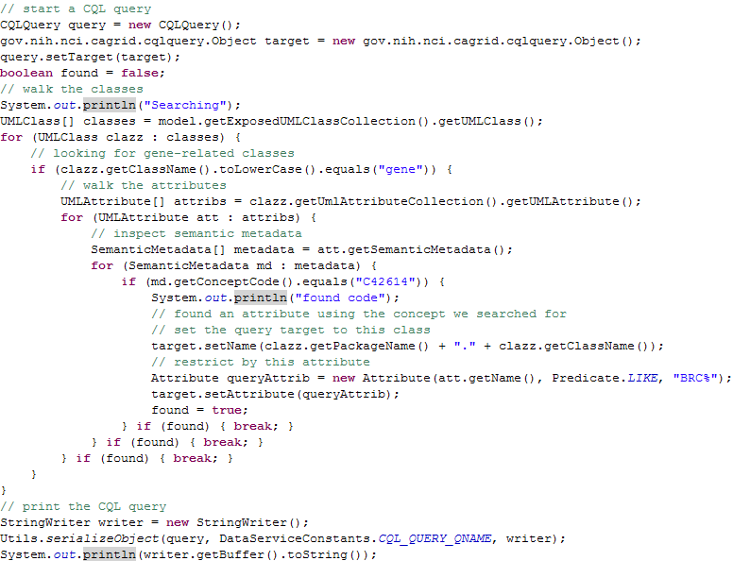
Data Service Client Workflow

Slide 44
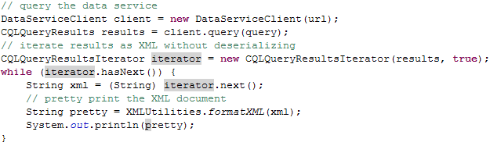
Data Service Client Workflow
Issue the CQL query and retrieve results
Using the XML-Only feature of the results iterator avoids attempting to deserialize the results into an object model the client probably doesn’t have java classes for locally
Client could generate these classes from XML schema using WSDL2Java or a similar tool

Slide 45
Federated Queries
Multiple Data Services Involved
Basic distributed joins and aggregations
All data services use the same language (CQL), so federation using multiple data services is possible
Any combination of data services may be used
Arbitrary cross-model joins
DCQL extends from CQL
Distributed version of CQL
Expresses joins, foreign data services, and target services
Stateful Grid Service or Local API
Queries may be issued to an FQP grid service and processed asynchronously for later results retrieval
FQP engine may be used within an application directly

Slide 46
Federated Query Workflow Example
A client wishes to submit a query to the FQP service
Query accesses multiple target data services
One or more of which is transient on the grid and might not be available at query time
Involves secure data services which require authentication from the client
Client wishes to use his own credentials, so the query returns data he is authorized to see
The client will retrieve the results of the query at a later time
The client does not want to busy-wait on the FQP service so it can go do other processing tasks

Slide 47
Federated Query Workflow Example
Client delegates credential to FQP using CDS
Client initiates Asynchronous DCQL query
Passes credential reference from CDS
Creates Query Execution Parameters to allow partial results
FQP Contacts CDS for the user’s credential
Credential is validated for same identity as caller
FQP creates a query results resource
Reference to the resource is returned
Query processing begins using the thread pool
Generated CQL is broadcast to involved data services
Client subscribes to the results resource status property
FQP completes processing and notifies the client
Client retrieves results from the resource

Slide 48
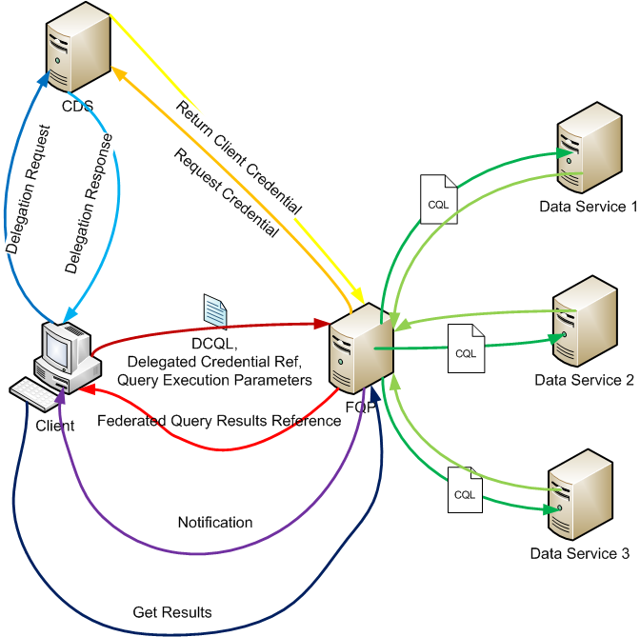
Federated Query Workflow Example

Slide 49
Federated Query Service
Asynchronous query execution
Start a DCQL query and immediately return the results context
WS-Notification allows client to subscribe to status
Processing complete, exception, querying target data service, etc.
Credential Delegation
FQP service may perform queries on behalf of a client
Leverages Credential Delegation Service (CDS)
Large results retrieval
WS-Enumeration and caGrid Transfer
Configurable Query Behavior
Failure handling, partial results retrieval, etc

Slide 50
Federated Query Service Security
FQP Service may be deployed securely
May employ HTTPS messaging to and from client
Can communicate securely with data services involved in a DCQL query if they employ security
Unless otherwise specified, host credential of the FQP service will be used
Credential Delegation Service may be used to query such services on behalf of the client
Caller – only query results resources
Asynchronous query operations create a resource which is only accessible to the original caller of the asynchronous operation
Resource configured to use Grid Map authorization and caller’s ID is the only entry in that Grid Map
Notes:
A DCQL (Which is just distributed CQL) can be used to make queries that are federated and require sub queries to be issues to other data services in order to dertime the result set. The main addition here is the ability to describe Forieng association which intern create remote joins to happen in the FQP Service.

Slide 51
Federated Query Service Security
Delegated credentials
A client may choose to delegate his credentials to the FQP service for secure communication with data services involved in a DCQL query
Client makes a delegation request to the CDS
Indicates the FQP service as the delegatee
CDS issues a Delegated Credential Reference
Indicates which CDS holds the credential and a unique key
The FQP service validates those credentials
The caller’s ID must match the identity contained in the credentials obtained from the CDS and be non-null
Subsequent calls to data services are executed securely, utilizing the client’s delegated credential
Secure grid calls now utilize caller’s ID in all cases – no anonymous queries
Notes:
A DCQL (Which is just distributed CQL) can be used to make queries that are federated and require sub queries to be issues to other data services in order to dertime the result set. The main addition here is the ability to describe Forieng association which intern create remote joins to happen in the FQP Service.

Slide 52
DCQL Components
DCQL builds on CQL
New types added to support joins
Foreign association, foreign object, join condition
Re-used data types where possible
Attribute and its predicates are directly from CQL
Matching names in most other cases
Group, object, association, etc look very similar to CQL
Target service URLs added to the root of the query
Specifies the context(s) in which to execute the query for the target object
Unlike CQL, where the service executing the query is the context
Notes:
A DCQL (Which is just distributed CQL) can be used to make queries that are federated and require sub queries to be issues to other data services in order to dertime the result set. The main addition here is the ability to describe Forieng association which intern create remote joins to happen in the FQP Service.

Slide 53
DCQL Components
DCQLQuery
The root element of any DCQL query
Contains a single TargetObject element
One to many target data service elements
Multiple target services provides for aggregation of results from multiple sources
Object
Identifies a data type
May be used as the TargetObject of a DCQL query
The data type which will be returned
Also may be used as an Association
Provides a restriction on its parent element
Adds the ForeignAssociation component over CQL
Notes:
A DCQL (Which is just distributed CQL) can be used to make queries that are federated and require sub queries to be issues to other data services in order to dertime the result set. The main addition here is the ability to describe Forieng association which intern create remote joins to happen in the FQP Service.

Slide 54
DCQL Components
Association
Describes a relationship between the parent and another data type
Inherits from the Object type
Additionally specifies the role name of this association
Attribute
Object property used as search criteria
Defined in terms of attribute name, predicate, and value
Predicates are similar to SQL
Equals, Not Equals, Like, Less Than, Greater Than, Less or Equal, Greater or Equal, Null, and Not Null
Type inherited from CQL directly without modification
Notes:
A DCQL (Which is just distributed CQL) can be used to make queries that are federated and require sub queries to be issues to other data services in order to dertime the result set. The main addition here is the ability to describe Forieng association which intern create remote joins to happen in the FQP Service.

Slide 55
DCQL Components
Foreign Association
Describes a relationship to data in another data service
Similar to Association – restricts the resulting data set
Identifies the remote data type and remote data service by URL
Join Condition
Used within the context of a Foreign Association
Specifies the way in which “local” and “foreign” data is related
Local and foreign attribute names
Identifies the join predicate
Equal To, Not Equal, Less Than, Less or Equal, Greater Than, Greater or Equal
Notes:
A DCQL (Which is just distributed CQL) can be used to make queries that are federated and require sub queries to be issues to other data services in order to dertime the result set. The main addition here is the ability to describe Forieng association which intern create remote joins to happen in the FQP Service.

Slide 56
DCQL Components
Group
Identical to CQL’s group with the addition of Foreign Associations
A logical grouping of query constraints
Logical operators AND and OR
TargetDataServiceURL
Identifies the context in which the target of the DCQL query should be found
Multiple target services yields an aggregation
The same CQL query is broadcast to each target data service
Results may be assembled to retain their context, or lumped together in a single CQL Query Results instance
Notes:
A DCQL (Which is just distributed CQL) can be used to make queries that are federated and require sub queries to be issues to other data services in order to dertime the result set. The main addition here is the ability to describe Forieng association which intern create remote joins to happen in the FQP Service.

Slide 57
Federated Query Execution
Simple synchronous querying
Most basic DCQL query mechanism
Client issues a DCQL query, gets a DCQL Query Results instance
execute() method - Results retain context, identified by source data service URL
executeAndAggregate() method – Results packed into a single CQL Query Results instance
Useful with existing tools for handling CQL results
Caveats
A single failure communicating with a target data service will cause the whole query to fail
No processing parameters specified to allow retries
No credential delegation

Slide 58
Federated Query Execution
Simple asynchronous querying
executeAsynchronously() method takes a DCQL query and returns a Federated Query Results Client
Server sets up a results resource and immediately begins execution utilizing the service’s thread pool
Caveats
A single failure communicating with a target data service will cause the whole query to fail
No processing parameters specified to allow retries
No credential delegation
Sophisticated asynchronous querying
query() method takes a DCQL query, an optional Delegated Credential Reference, and an optional Query Execution Parameters instance
Full control - none of the caveats of the simple method

Slide 59
Federated Query Execution
Query Execution Parameters
Optional parameter to the asynchronous query method
Specifies how the FQP service should handle failures when communicating with target data services
Fail-fast (default)
Any error cancels the whole query and throws an exception
Partial results
Errors are logged for later inspection
Results from target services without error are recorded
Retries
Client may specify number of retries and timeout between them
Query execution parameters constrained by configurable service properties
Prevents malicious clients from asking for an unreasonable number of retries and time, effectively causing a DoS

Slide 60
Federated Query Example
In this example, a query is started using the delegated credential and query execution parameters features
The client’s credential is loaded
The delegation parameters are specified
Path length, delegatee, etc
The CDS is contacted using the special delegation user client to delegate the credential according to the parameters
The FQP service client is created using the client’s credential
A DCQL query is created or loaded
Query execution parameters specify 10 retries, 30 seconds apart if a target service fails
The query is executed asynchronously, passing the delegation reference and the query execution parameters

Slide 61
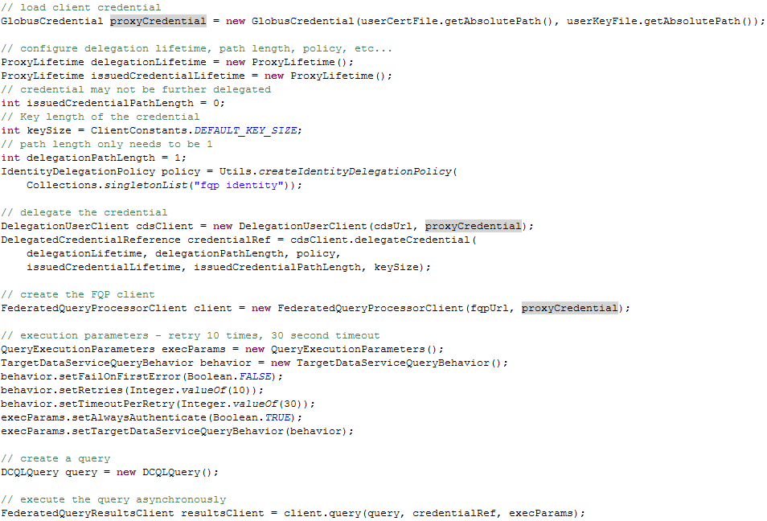
Federated Query Example

Slide 62
Federated Query Resource Properties
The FQP Results Service publishes execution status through a resource property
Contains the processing status of the DCQL query
Waiting, Processing, Complete, Complete with error
Indicates which target data services have been contacted and what the status of that query execution was
Completed, Connection problem, other Exception
Identifies the range in the result set which was generated by each target data service
Even in aggregation scenarios, it is possible to poll this value and identify the context for each result

Slide 63
Federated Query Resource Properties
The processing status resource property supports WS-Notification
Notification allows the service to “push” information to the client, typically in response to some server-side event
Clients may subscribe to this resource property and receive updates when it changes
Allows clients to wait for processing to complete without continuously polling the isProcessingComplete() method if the FederatedQueryResultsClient
Can be used to keep clients appraised of current query status
Progress bar, status box, logging, etc.

Slide 64
DCQL Aggregation Example
Aggregate data from multiple sources
Simultaneous query execution up to thread pool size
Example query
Return instances of the gene data type
Each gene must have an association to an instance of the term data type via the role name terms
Each term must have it's value attribute equal to “root”
The query is executed on two data services, each indicated by the targetServiceUrl elements at the end of the query
<ns1:DCQLQuery xmlns:ns1=http://caGrid.caBIG/1.0/gov.nih.nci.cagrid.dcql>
<ns1:TargetObject name="model1.domain.Gene">
<ns1:Association name="model1.domain.Term" roleName="terms">
<ns1:Attribute name="value" predicate="EQUAL_TO" value="root"/>
</ns1:Association>
</ns1:TargetObject>
<ns1:targetServiceURL>http://sbdev1000.semanticbits.com:13080/wsrf-model1/services/cagrid/Model1Svc</ns1:targetServiceURL>
<ns1:targetServiceURL>http://sbdev1000.semanticbits.com:13080/wsrf-model1-a/services/cagrid/Model1Svc</ns1:targetServiceURL>
</ns1:DCQLQuery>
Notes:
A DCQL (Which is just distributed CQL) can be used to make queries that are federated and require sub queries to be issues to other data services in order to dertime the result set. The main addition here is the ability to describe Forieng association which intern create remote joins to happen in the FQP Service.

Slide 65
DCQL Distributed Join Example
Joins between disparate data models and services
Simple join criteria on attribute values
Example Query
Return instances of caBIO model’s NucleicAcidSequence
Each sequence must have an association to a Gene through the role name geneCollection
Each gene has an association to Protein through proteinCollection
A ForeignAssociation indicates a new query is started against a different caGrid data service (gridPIR)
The JoinCondition element indicates how a field from the “foreign” data type relates to a field of the “origin” data type
The foreign data type is Protein
Each protein instance must have two associations; one to Gene and one to Organism (both within gridPIR)
Notes:
A DCQL (Which is just distributed CQL) can be used to make queries that are federated and require sub queries to be issues to other data services in order to dertime the result set. The main addition here is the ability to describe Forieng association which intern create remote joins to happen in the FQP Service.

Slide 66
DCQL Distributed Join Example
<ns1:DCQLQuery xmlns:ns1="http://caGrid.caBIG/1.0/gov.nih.nci.cagrid.dcql">
<ns1:TargetObject name="gov.nih.nci.cabio.domain.NucleicAcidSequence">
<ns1:Association name="gov.nih.nci.cabio.domain.Gene" roleName="geneCollection“>
<ns1:Association name="gov.nih.nci.cabio.domain.Protein" roleName="proteinCollection“>
<ns1:ForeignAssociation targetServiceURL="http://141.161.25.20:8080/wsrf/services/cagrid/GridPIR">
<ns1:JoinCondition foreignAttributeName="uniprotkbEntryName" localAttributeName="uniProtCode" predicate="EQUAL_TO"/>
<ns1:ForeignObject name="edu.georgetown.pir.domain.Protein">
<ns1:Group logicRelation="AND“>
<ns1:Association name="edu.georgetown.pir.domain.Gene" roleName="geneCollection“>
<ns1:Attribute name="name" predicate="EQUAL_TO" value="brca1"/>
</ns1:Association>
<ns1:Association name="edu.georgetown.pir.domain.Organism" roleName="organismCollection">
<ns1:Attribute name="scientificName" predicate="EQUAL_TO" value="homo sapiens"/>
</ns1:Association> </ns1:Group>
</ns1:ForeignObject>
</ns1:ForeignAssociation>
</ns1:Association>
</ns1:Association>
</ns1:TargetObject>
<ns1:targetServiceURL>http://cabiogrid32.nci.nih.gov:80/wsrf/services/cagrid/CaBIO32GridSvc</ns1:targetServiceURL>
</ns1:DCQLQuery>
Notes:
A DCQL (Which is just distributed CQL) can be used to make queries that are federated and require sub queries to be issues to other data services in order to dertime the result set. The main addition here is the ability to describe Forieng association which intern create remote joins to happen in the FQP Service.

Slide 67
Future Developments
CQL 2 will contain several new features and enhancements
New aggregation capabilities (min, max, count)
Strongly typed attribute values
Avoid ambiguities passing around string representations
Differentiation of Unary and Binary attribute restrictions
Reduces processing to determine the nature of an attribute
Improves clarity of query language schema
Associated object retrieval
Associations can be populated by the data service before returning object instances
Retrieval based on role names or depth of association
Name-based retrieval is recursively defined, allowing population of specific associations of associations through the model
Feature requests and use cases gathered from the user community and other stakeholders in future caGrid development
Notes:
A DCQL (Which is just distributed CQL) can be used to make queries that are federated and require sub queries to be issues to other data services in order to dertime the result set. The main addition here is the ability to describe Forieng association which intern create remote joins to happen in the FQP Service.

Slide 68
Future Developments
DCQL 2 inherits from CQL 2
Most - if not all - new features of CQL 2 will be ported to DCQL 2
Simple data transformations on joins
“Give me all samples where freezing time is 30 minutes or less after collection time”
Apply a fixed value transformation to either side of the join (foreign or local) before computing the join
Simplification of Foreign Association syntax to look more like Associations
Less verbose query language without sacrificing functionality
Notes:
A DCQL (Which is just distributed CQL) can be used to make queries that are federated and require sub queries to be issues to other data services in order to dertime the result set. The main addition here is the ability to describe Forieng association which intern create remote joins to happen in the FQP Service.

